Slide 1
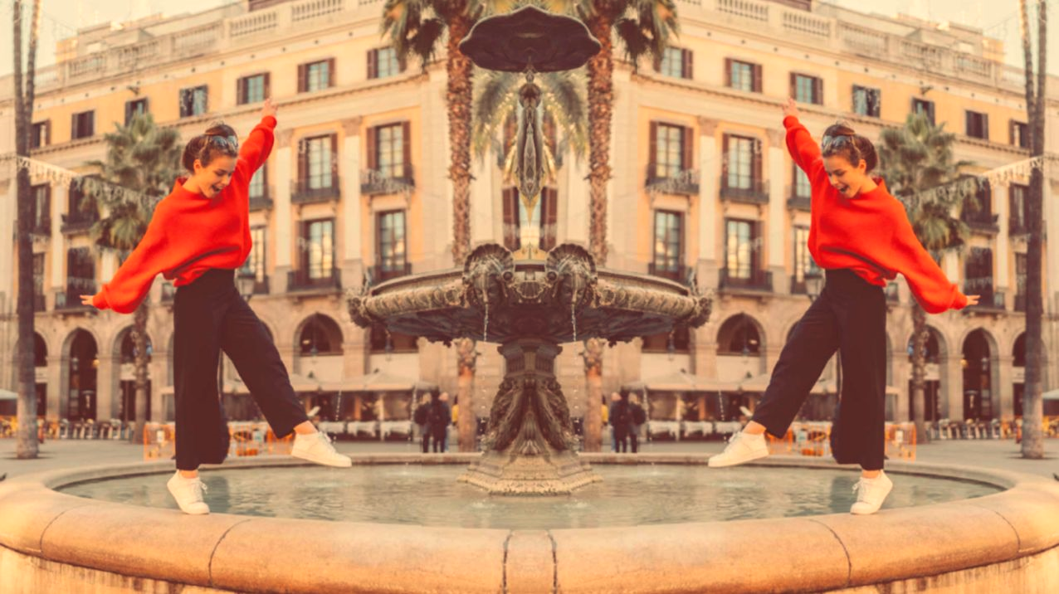
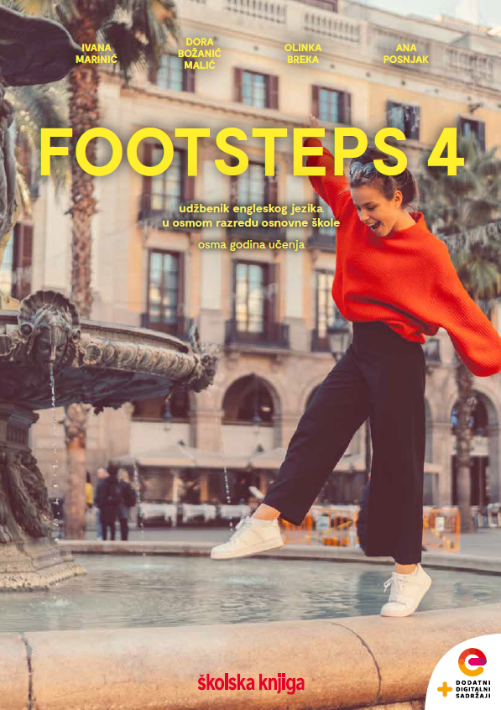

UNIT 5; Tick tock
Self-check 5

Slide 2
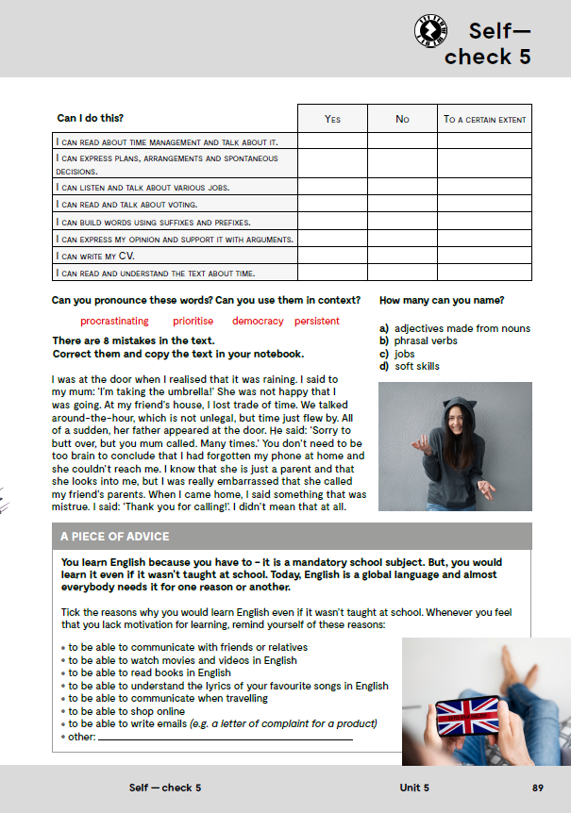
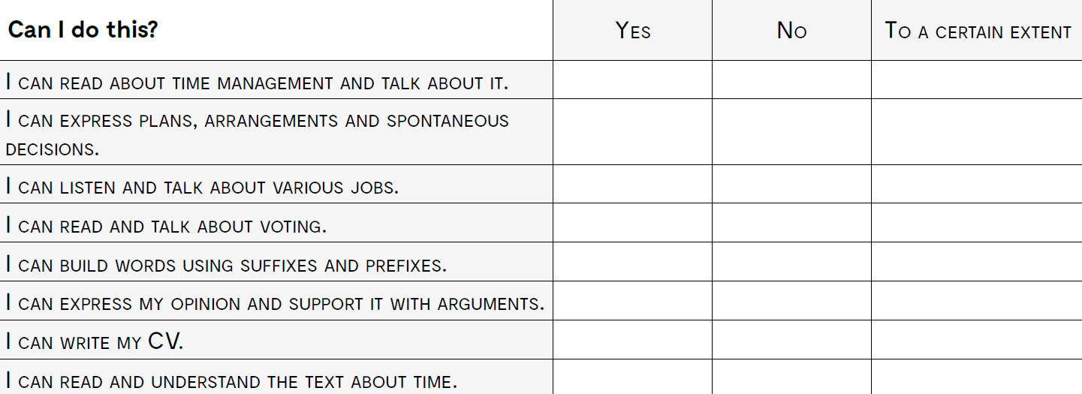
čitati o upravljanju vremenom i razgovarati o toj temi
izraziti planove, dogovore i spontane odluke
slušati i pričati o različitim zanimanjima
čitati i pričati o glasanju
tvoriti riječi uz pomoć sufiksa i prefiksa
izraziti svoje vlastito mišljenje i izreći argumente koji ga podržavaju
napisati vlastiti životopis
pročitati i razumjeti tekst o vremenu

Slide 3
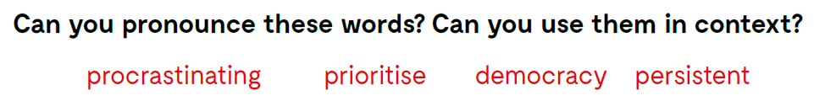
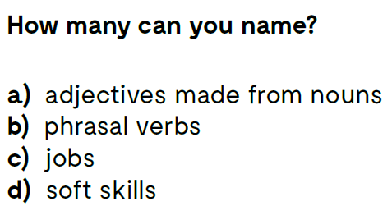

Slide 4
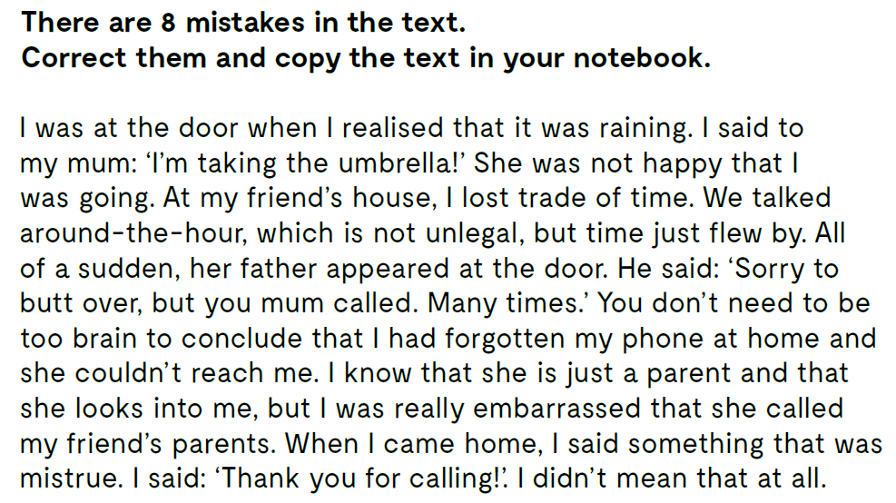
I was at the door when I realised that it was raining. I said to my mum: ‘I’ll take the umbrella!’ She was not happy that I was going.
At my friend’s house, I lost track of time.
We talked around-the-clock, which is not illegal, but time just flew by. All of a sudden, her father appeared at the door.
He said: ‘Sorry to butt in, but you mum called. Many times.’
You don’t need to be too brainy to conclude that I had forgotten my phone at home and she couldn’t reach me.
I know that she is just a parent and that she looks over me, but I was really embarrassed that she called my friend’s parents.
When I came home, I said something that was a lie. I said: ‘Thank you for calling!’. I didn’t mean that at all.

Slide 5
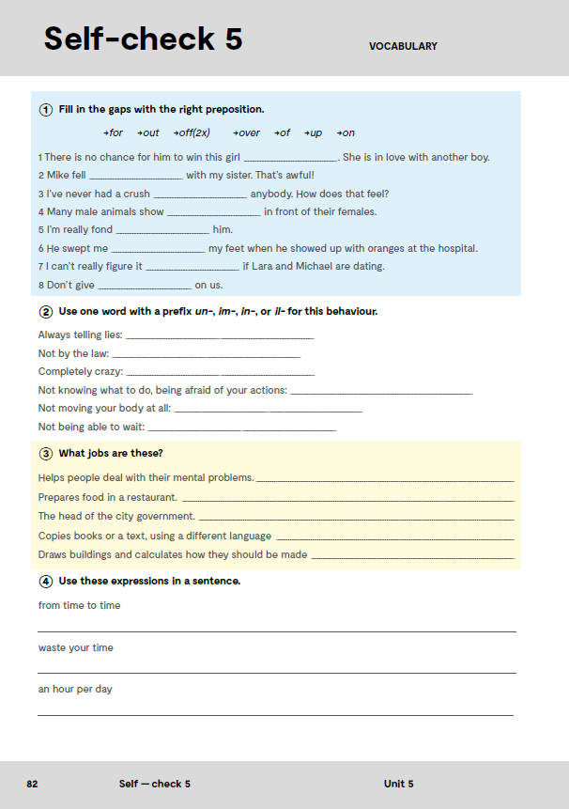
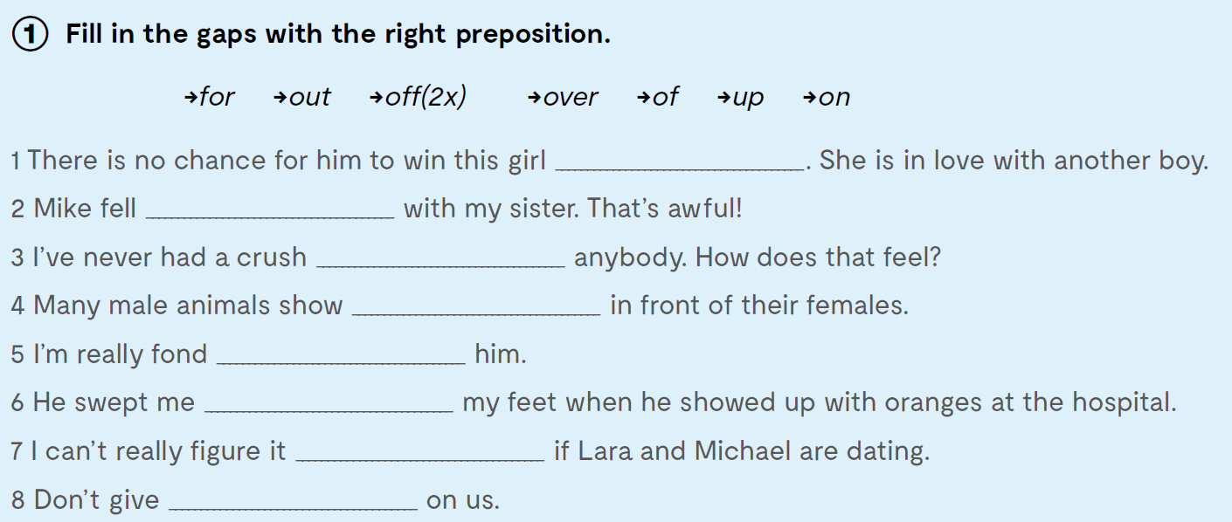

Workbook, page 82.
over
for
on
off
of
off
out
up
Check what you have learnt:
https://www.bookwidgets.com/play/8CANB8W

Slide 6
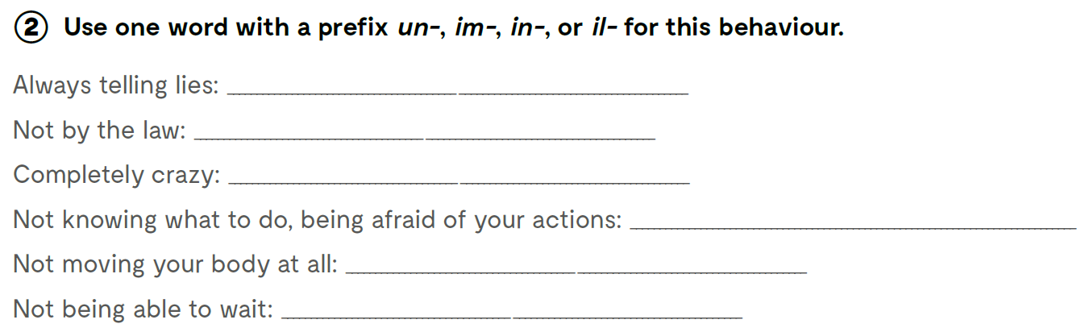
untrue
illegal
insane
insecure
inactive
impatient

Slide 7
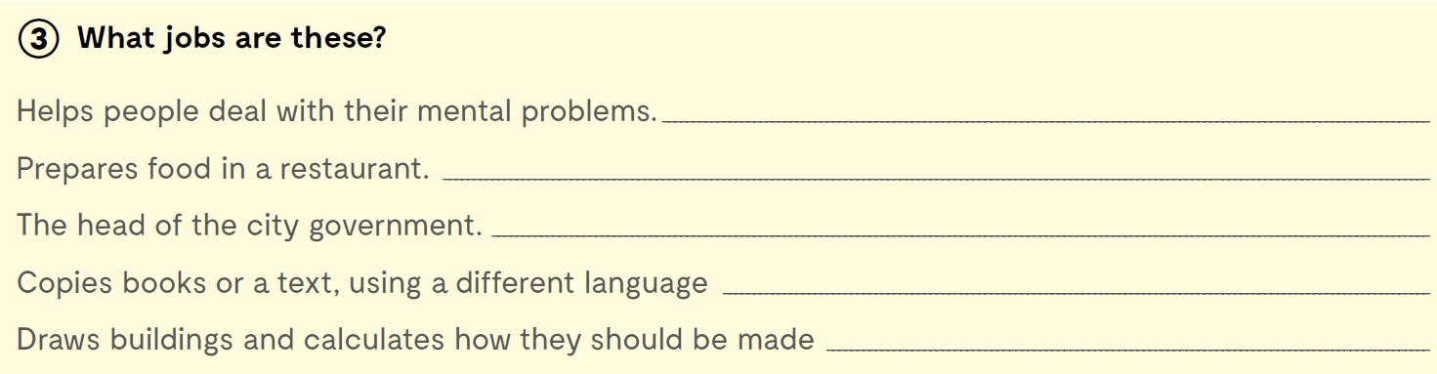
What jobs are these?
a psychiatrist
a cook
a mayor
a translator
an architect

Slide 8
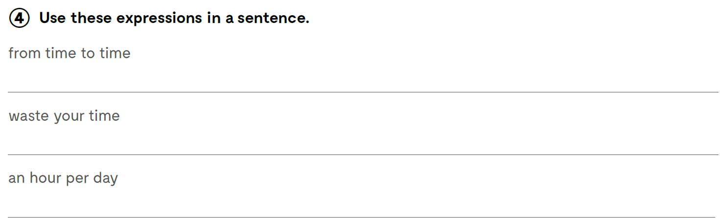
Use these expressions in a sentence.

Slide 9
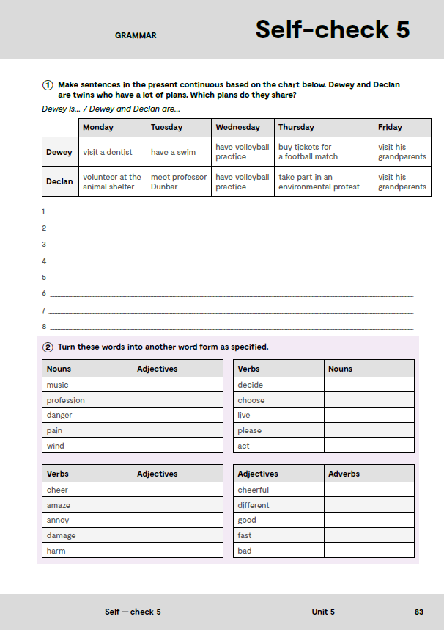
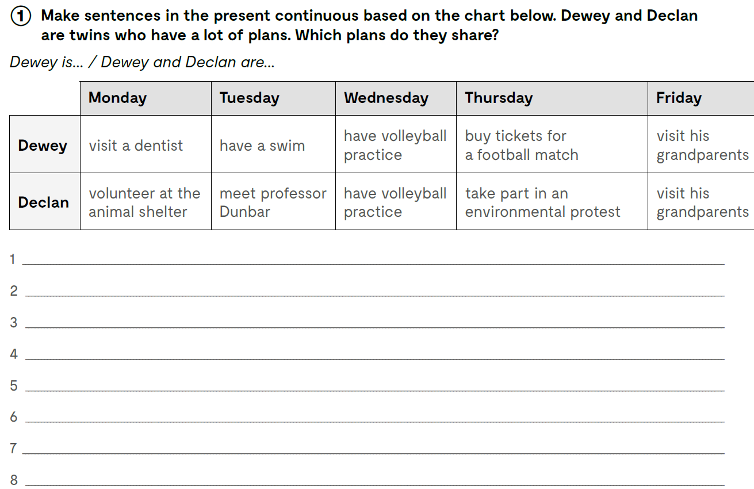
On the next page, page 83.
Dewey is visiting a dentist on Monday.
Declan is volunteering at the animal shelter on Monday.
Dewey is having a swim on Tuesday.
Declan is meeting professor Dunbar on Tuesday.
Dewey and Declan are having volleyball practice on Wednesday.
Dewey is buying tickets for a football match on Thursday.
Declan is taking part in an environmentalist protest on Thursday.
Dewey and Declan are visiting their grandparents on Friday.

Slide 10
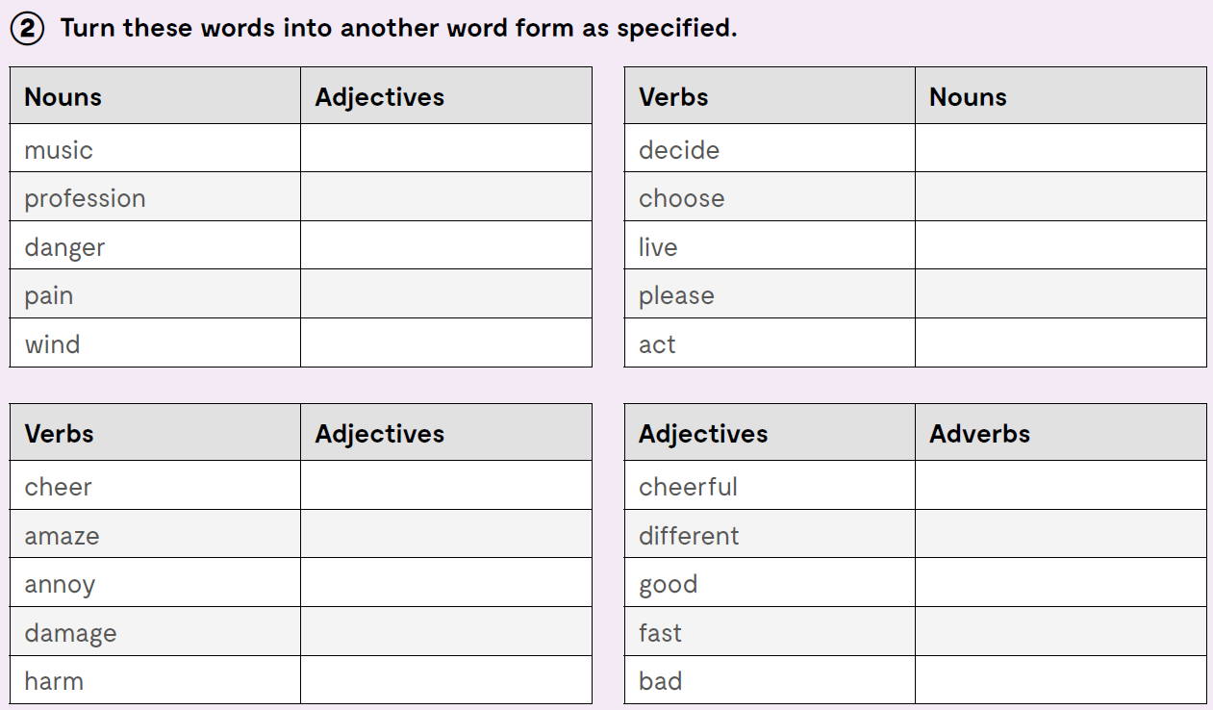
musical
professional
dangerous
painful
windy
decision
choice
life
pleasure
actor
cheerful
amazing
annoying
damaged/damaging
harmful
cheerfully
differently
well
fast
badly

Slide 11
